Slide 1
Computer Science - Fundamental
Jason Jin
Aug 2013

Slide 2
Introduction
Objectives
Provide general introduction for Computer Science.
Provide necessary training for non-IT major colleague.
Provide preparatory training for Java training.
What is a Computer?
Electronic device operating under the control of instructions stored in its own memory
What is Computer Science
The scientific and practical approach to computation and its applications.

Slide 3
Computer Science - Fundamental
1 | History of Computer
2 | Hardware
3 | Software
4 | Network

Slide 4
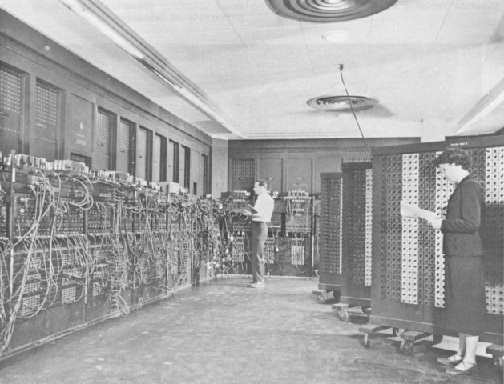
Electrical Numerical Integrator and Computer (ENIAC), 1946
Size:
30’ x 50’ room
18,000 vacuum tubes
weighed 30 tons
at the University of Pennsylvania
Designers:
John Mauchly
J. Presper Eckert
It used thousands of vacuum tubes, crystal diodes, relays, resistors, and capacitors.

Slide 5
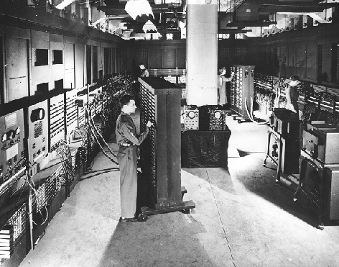
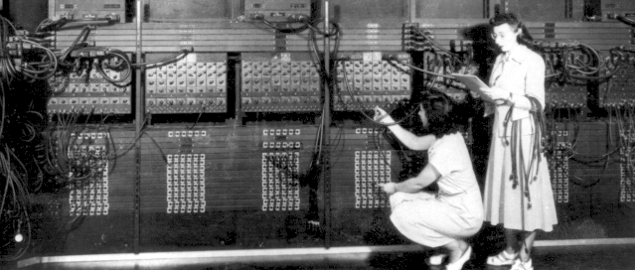
Electrical Numerical Integrator and Computer (ENIAC), 1946
To reprogram the ENIAC you had to rearrange the patch cords that you can observe on the left in the prior photo, and the settings of 3000 switches that you can observe on the right.

Slide 6
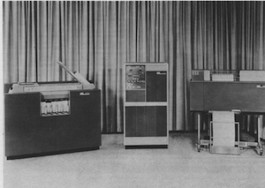
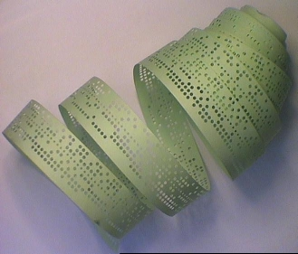
Second Generation Computers (1955 – 1960)
IBM 1401
The second generation of computers came about thanks to the invention of the transistor, which then started replacing vacuum tubes in computer design. Transistor computers consumed far less power, produced far less heat, and were much smaller compared to the first generation.

Slide 7
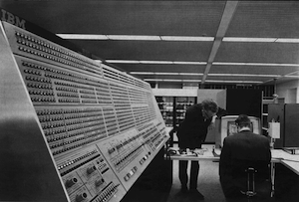
Third Generation Computers (1960s)
IBM System/360
The invention of the integrated circuits (ICs), also known as microchips, paved the way for computers as we know them today. Making circuits out of single pieces of silicon, which is a semiconductor, allowed them to be much smaller and more practical to produce.

Slide 8
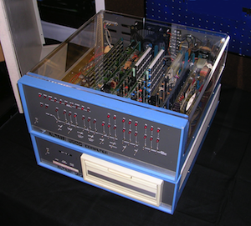
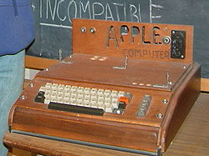
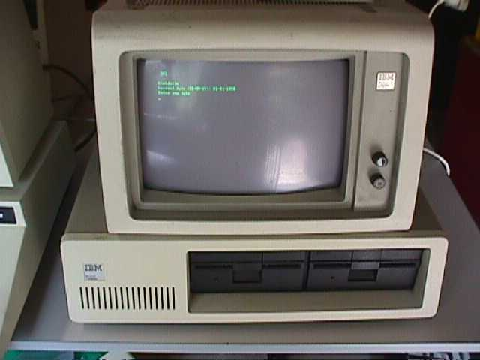
Fourth Generation Computers (1971 – present)
First microchips-based central processing units consisted of multiple microchips for different CPU components. The drive for ever greater integration and miniaturization led towards single-chip CPUs, where all of the necessary CPU components were put onto a single microchip, called a microprocessor. The first single-chip CPU, or a microprocessor, was Intel 4004.
Altair 8800, first PC
Apple I
IBM PC

Slide 9
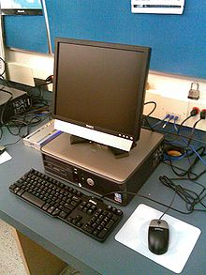
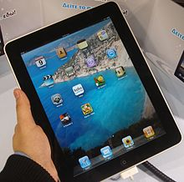
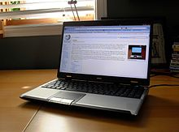
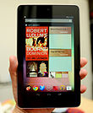
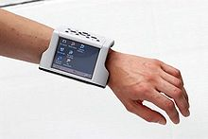
Modern Computer

Slide 10
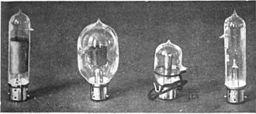

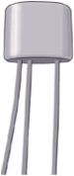
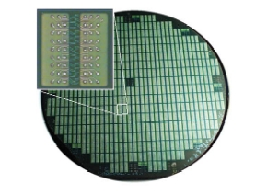
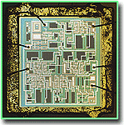
Infrastructure
Diode
Triode
transistors
Very Large Scale Integration(VLSI)
millions of transistors per chip
Integrated Circuit (IC)

Slide 11

John von Neumann
Von Neumann architecture
stored-program computer
both data and program must be stored in memory.
Binary System
http://en.wikipedia.org/wiki/John_von_Neumann
“If people do not believe that mathematics is simple, it is only
because they do not realize how complicated life is.”
― John von Neumann

Slide 12
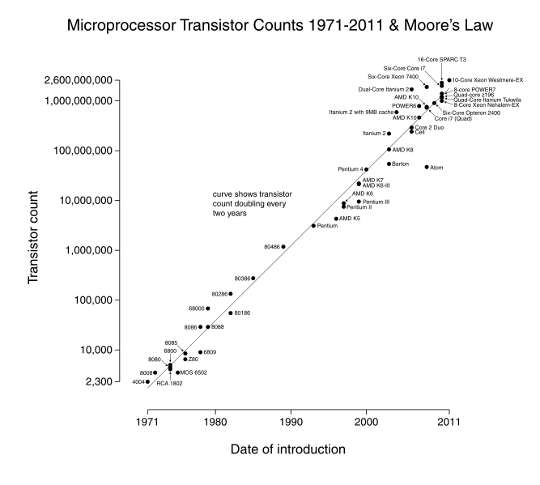
Moore’s Law
The number of transistors on integrated circuits doubles approximately every two years.

Slide 13
Computer Science - Fundamental
 | History of Computer
 | Hardware
 | Software
 | Network

Slide 14
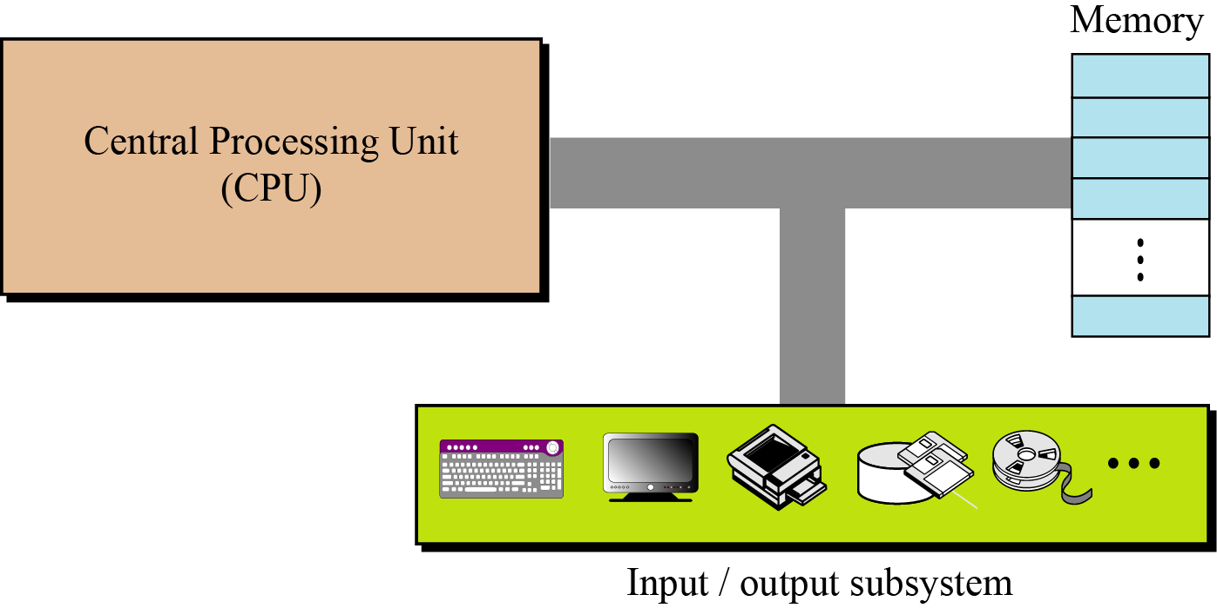
Category
Central Processing Unit - also called “The Chip”, a CPU, a processor, or a microprocessor
Memory (RAM)
Input Devices
Output Devices

Slide 15
Computer Science - Fundamental
 | History of Computer
 | Hardware
 | CPU
 | Memory
 | I/O Device
 | Connection
 | Number System
 | Data Storage
 | Software
 | Network

Slide 16
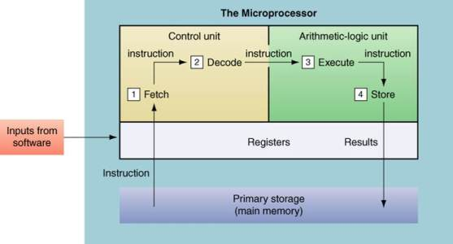
CPU
Central Processing Unit - also called “The Chip”, a CPU, a processor, or a microprocessor
CPU or microprocessor is often described as the brain of a computer.
CPU is an integrated circuit or “chip” which processes instructions and data.
CPU speed is measured by the number of completed instruction cycles per second
Currently, CPU speeds range from 600 megahertz (MHz or million cycles per second) to 4 gigahertz (GHz or billion cycles per second).
Two typical components of a CPU are
Arithmetic logic unit (ALU), which performs arithmetic and logical operations
Control unit (CU), which extracts instructions from memory and decodes and executes them, calling on the ALU when necessary.
Other important components
Register

Slide 17
ALU
ALUs routinely perform the following operations:
Logical Operations: These include AND, OR, NOT, XOR, NOR, NAND, etc.
Bit-Shifting Operations: This pertains to shifting the positions of the bits by a certain number of places to the right or left, which is considered a multiplication operation.
Arithmetic Operations: This refers to bit addition and subtraction. Although multiplication and division are sometimes used, these operations are more expensive to make.

Slide 18
CU
CU functions are as follows:
Controls sequential instruction execution
Interprets instructions
Guides data flow through different computer areas
Regulates and controls processor timing
Sends and receives control signals from other computer devices
Handles multiple tasks, such as fetching, decoding, execution handling and storing results

Slide 19
Register
A, special, high-speed storage area within the CPU.
Registers are the top of the memory hierarchy and are the fastest way for the system to manipulate data.
All data must be represented in a register before it can be processed. For example, if two numbers are to be multiplied, both numbers must be in registers, and the result is also placed in a register.
Some of these registers are
Data registers
Instruction register
Program counter

Slide 20
Computer Science - Fundamental
 | History of Computer
 | Hardware
 | CPU
 | Memory
 | I/O Device
 | Connection
 | Number System
 | Data Storage
 | Software
 | Network

Slide 21
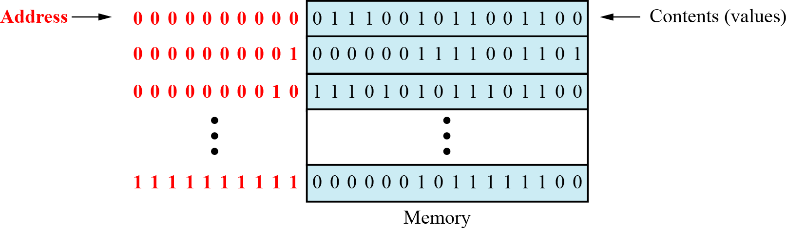
Memory
Memory refers to the physical devices used to store programs (sequences of instructions) or data (e.g. program state information) on a temporary or permanent basis for use in a computer or other digital electronic device.
It consists of a collection of storage locations, each with a unique identifier, called an address.
Data is transferred to and from memory in groups of bits called words.
A word can be a group of 8 bits, 16 bits, 32 bits or 64 bits (and growing).
If the word is 8 bits, it is referred to as a byte.
The term “byte” is so common in computer science that sometimes a 16-bit word is referred to as a 2-byte word, or a 32-bit word is referred to as a 4-byte word

Slide 22
Memory
To access a word in memory requires an identifier.
Although programmers use a name to identify a word (or a collection of words), at the hardware level each word is identified by an address.
The total number of uniquely identifiable locations in memory is called the address space.
For example, a memory with 64 kilobytes and a word size of 1 byte has an address space that ranges from 0 to 65,535.
Unit | Exact Number of Bytes | Approximation
Kilo byte (KB) | 2¹⁰(1024) bytes | 10³bytes
Mega byte(MB) | 2²⁰(1,048,576) bytes | 10⁶bytes
Giga byte(GB) | 2³⁰(1,073,741,824) bytes | 10⁹bytes
Tera byte(TB) | 2⁴⁰bytes | 10¹²bytes
Memory Units

Slide 23
Memory Types
Two main types of memory exist: RAM and ROM.
Random access memory (RAM)
Static RAM (SRAM)
Dynamic RAM (DRAM)
Read-only memory (ROM)
Programmable read-only memory (PROM).
Erasable programmable read-only memory (EPROM).
Electrically erasable programmable read-only memory (EEPROM).

Slide 24
Memory Types
Type of Memory | What Does It Do? | When Is It Used?
Read-only memory (ROM) | Stores permanent information like telling the computer how to start up | When you turn a computer on or off
Random-access memory (RAM) | Stores temporary information when you are working in a file | When you start and use software

Slide 25
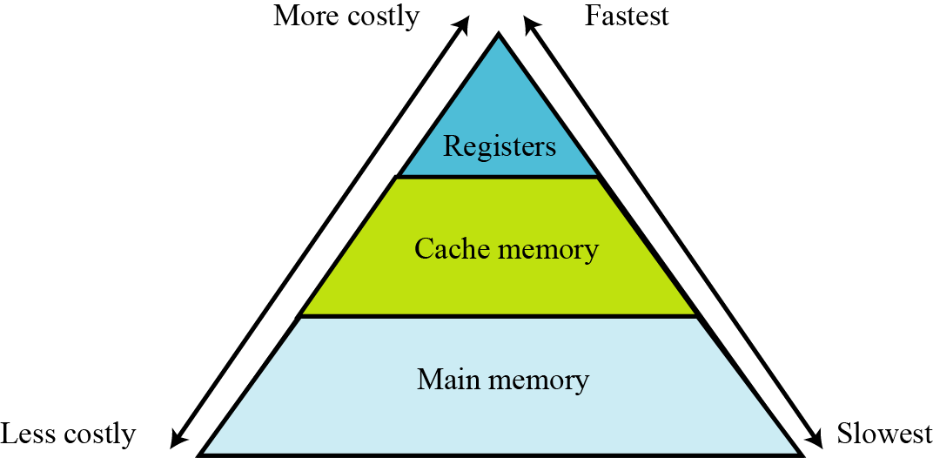
Memory Hierarchy
Computer users need a lot of memory, especially memory that is very fast and inexpensive. This demand is not always possible to satisfy—very fast memory is usually not cheap. A compromise needs to be made. The solution is hierarchical levels of memory.

Slide 26
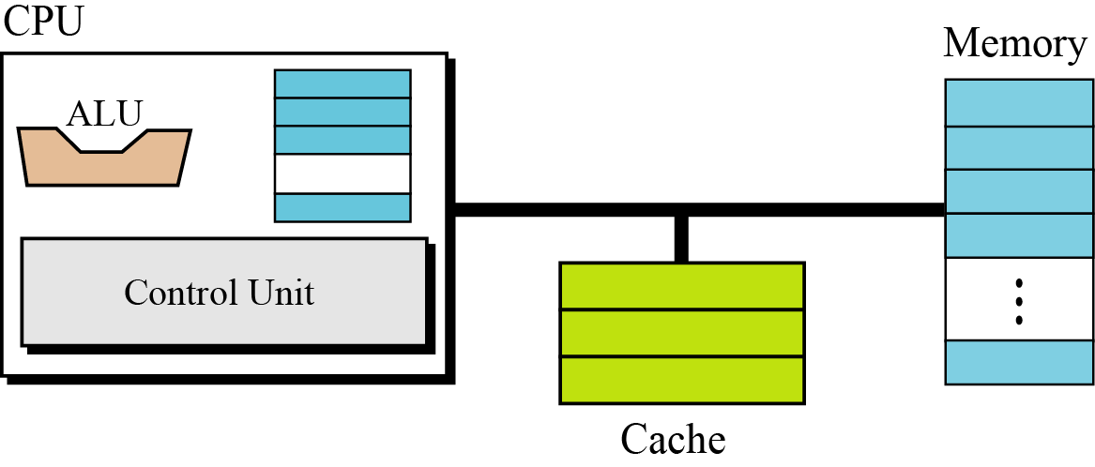
Cache Memory
Cache memory is faster than main memory, but slower than the CPU and its registers. Cache memory, which is normally small in size, is placed between the CPU and main memory

Slide 27
Exercise
Example 1
A computer has 32 MB (megabytes) of memory. How many bits are needed to address any single byte in memory?
Solution
The memory address space is 32 MB, or 225 (25 × 220). This means that we need log2 225, or 25 bits, to address each byte.
Example 2
A computer has 128 MB of memory. Each word in this computer is eight bytes. How many bits are needed to address any single word in memory?
Solution
The memory address space is 128 MB, which means 227. However, each word is eight (23) bytes, which means that we have 224 words. This means that we need log2 224, or 24 bits, to address each word.

Slide 28
Computer Science - Fundamental
 | History of Computer
 | Hardware
 | CPU
 | Memory
 | I/O Device
 | Connection
 | Number System
 | Data Storage
 | Software
 | Network

Slide 29
I/O Device
The third major subsystem in a computer is the collection of devices referred to as the input/output (I/O) subsystem.
This subsystem allows a computer to communicate with the outside world and to store programs and data even when the power is off.
Input/output devices can be divided into two broad categories
non-storage
storage devices.

Slide 30
Non-storage Devices
Non-storage devices allow the CPU/memory to communicate with the outside world, but they cannot store information.
Keyboard
Mouse
Monitor
Printer
Scanner

Slide 31
Storage Devices
Storage devices, although classified as I/O devices, can store large amounts of information to be retrieved at a later time.
They are cheaper than main memory, and their contents are nonvolatile—that is, not erased when the power is turned off.
They are sometimes referred to as auxiliary storage devices.
We can categorize them as either
Magnetic
Optical

Slide 32
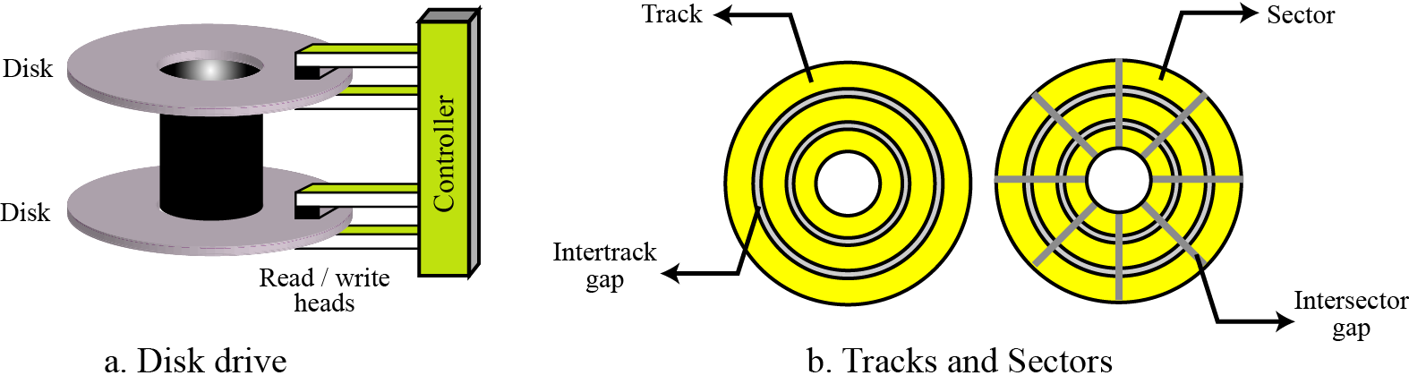
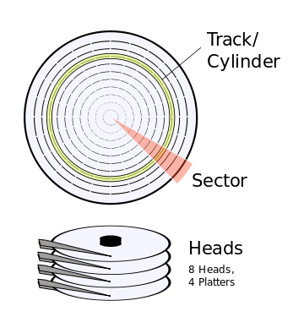
Magnetic Disk
A magnetic disk
Cylinders
Tracks
Sectors

Slide 33
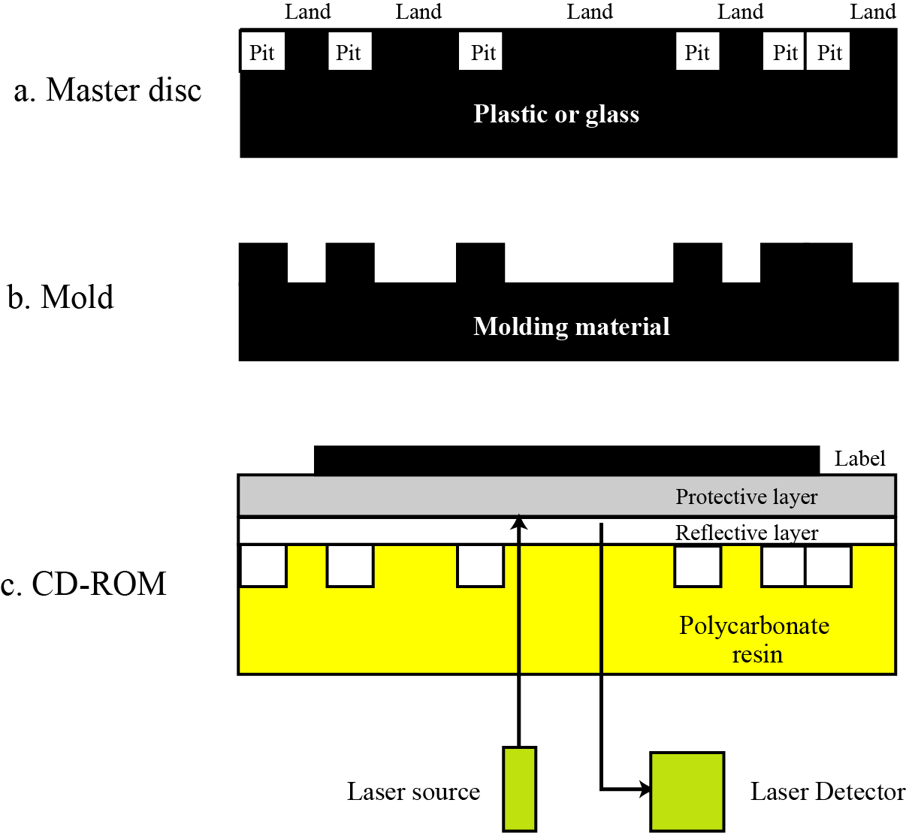
Optical Disk

Slide 34
Computer Science - Fundamental
 | History of Computer
 | Hardware
 | CPU
 | Memory
 | I/O Device
 | Connection
 | Number System
 | Data Storage
 | Software
 | Network

Slide 35
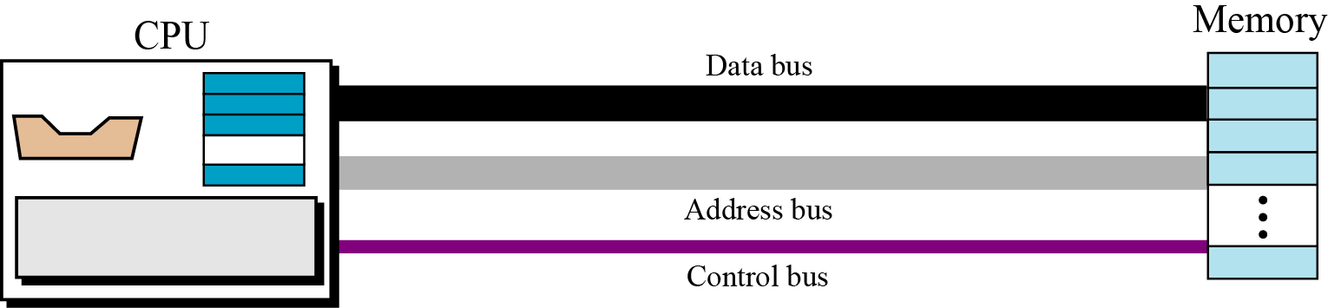
Connecting CPU and memory
The CPU and memory are normally connected by three groups of connections, each called a bus:
data bus
address bus
control bus

Slide 36
Bus
Address Bus: It is a group of wires or lines that are used to transfer the addresses of Memory or I/O devices.
Data Bus: As name tells that it is used to transfer data within Microprocessor and Memory/Input or Output devices. It is bidirectional as Microprocessor requires to send or receive data. The data bus also works as address bus when multiplexed with lower order address bus.
Control Bus: Microprocessor uses control bus to process data, that is what to do with the selected memory location. Some control signals are Read, Write and OP code fetch etc. Various operations are performed by microprocessor with the help of control bus. This is a dedicated bus, because all timing signals are generated according to control signal.

Slide 37
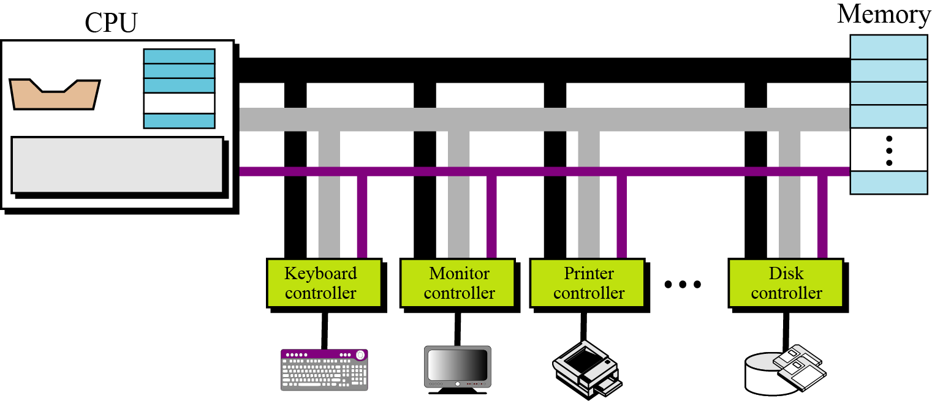
Connecting I/O Devices
I/O devices cannot be connected directly to the buses that connect the CPU and memory, because the nature of I/O devices is different from the nature of CPU and memory.
I/O devices are electromechanical, magnetic, or optical devices, whereas the CPU and memory are electronic devices. I/O devices also operate at a much slower speed than the CPU/memory. There is a need for some sort of intermediary
to handle this difference.
Input/output devices are therefore attached to the buses through input/output controllers or interfaces. There is one specific controller for each input/output device.

Slide 38
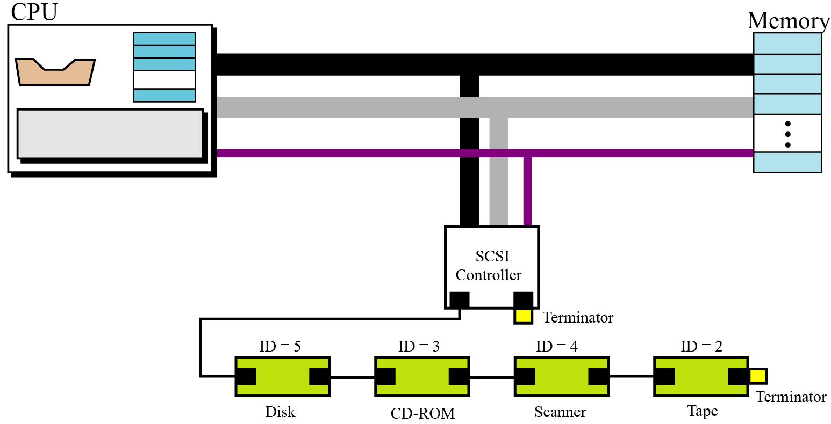
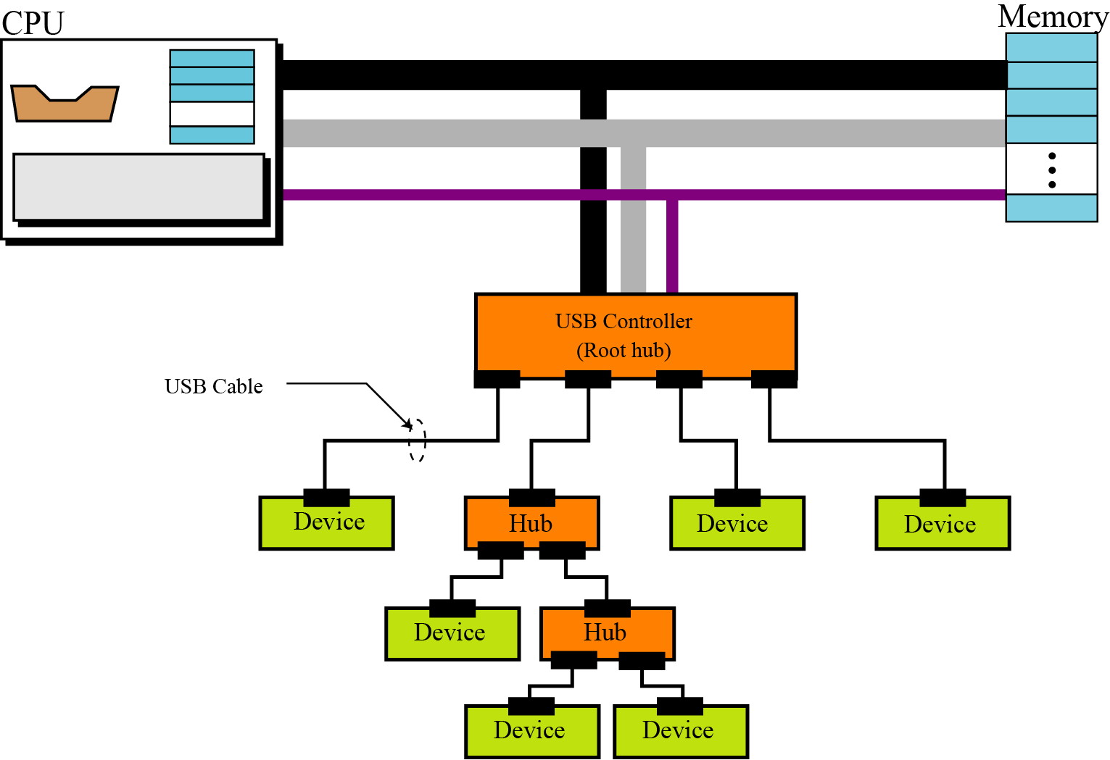
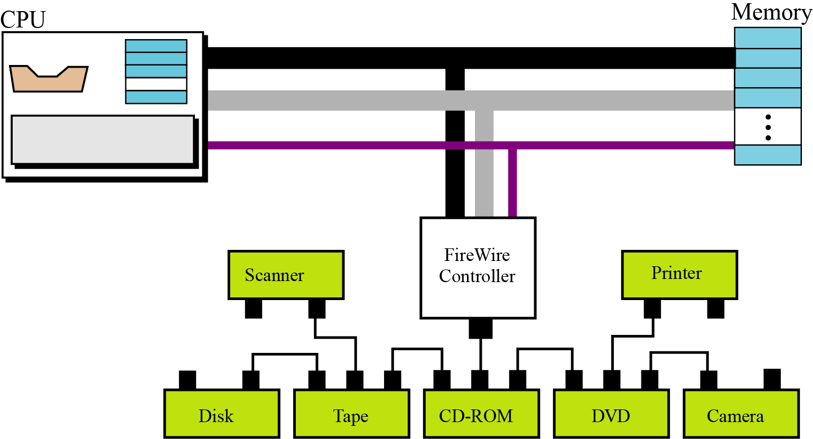
Connecting I/O Devices

Slide 39
Addressing input/output devices
The CPU usually uses the same bus to read data from or write data to main memory and I/O device.
The only difference is the instruction. If the instruction refers to a word in main memory, data transfer is between main memory and the CPU. If the instruction identifies an I/O device, data transfer is between the I/O device and the CPU.
There are two methods for handling the addressing of I/O devices: isolated I/O and memory-mapped I/O.

Slide 40
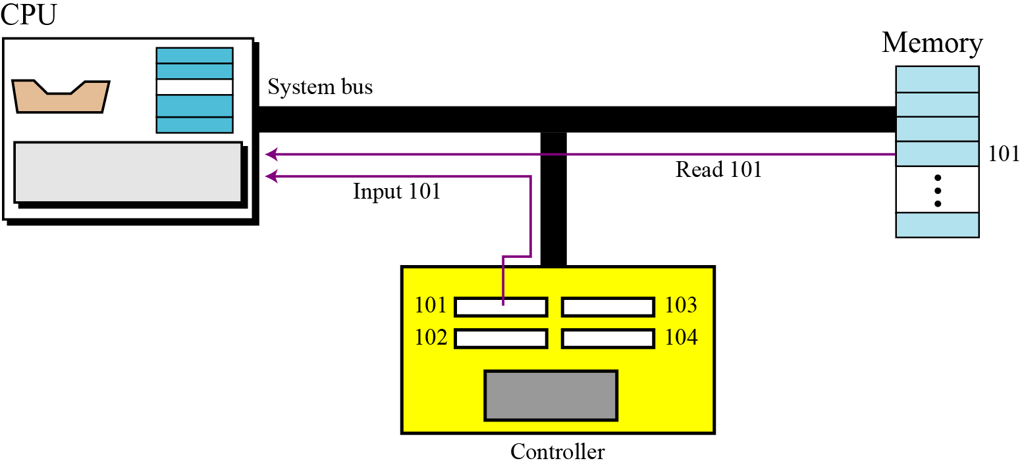
Isolated I/O Addressing

Slide 41
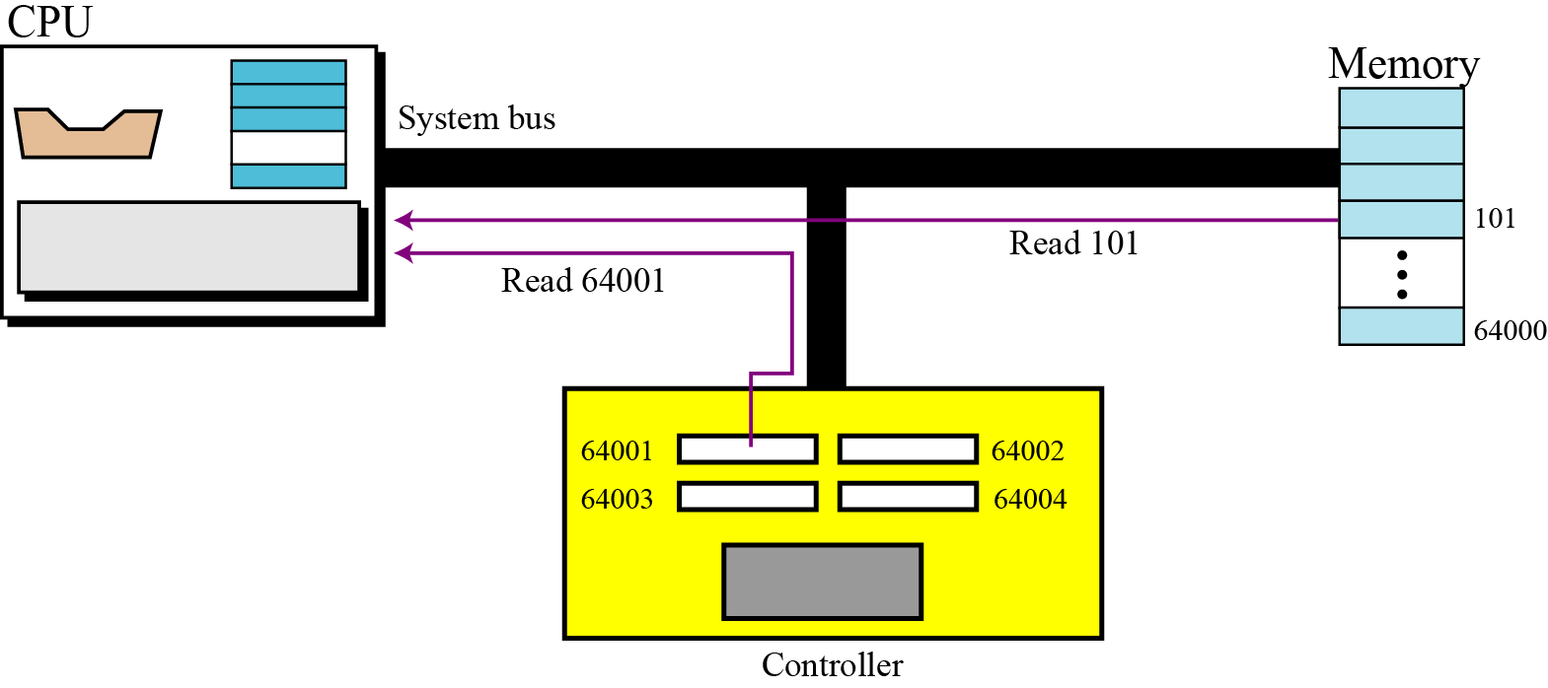
Memory-mapped I/O addressing

Slide 42
Computer Science - Fundamental
 | History of Computer
 | Hardware
 | CPU
 | Memory
 | I/O Device
 | Connection
 | Number System
 | Data Storage
 | Software
 | Network

Slide 43
Number System
A number system defines how a number can be represented using distinct symbols.
A number can be represented differently in different systems.
For example, the two numbers (2A)₁₆ and (52)₈ both refer to the same quantity, (42)₁₀, but their representations are different.
A number represented as:
has the value of:
in which S is the set of symbols, b is the base (or radix).

Slide 44
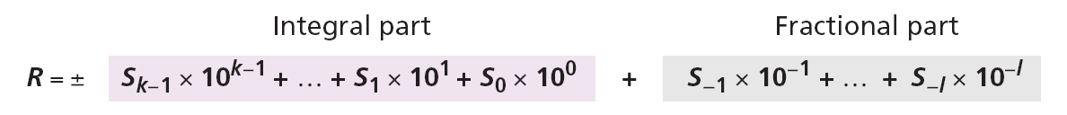
The Decimal System
The word decimal is derived from the Latin root decem (ten). In this system the base b = 10 and we use ten symbols
The symbols in this system are often referred to as decimal digits or just digits.
S = {0, 1, 2, 3, 4, 5, 6, 7, 8, 9}

Slide 45
Example 1
The following shows the place values for the integer +224 in the decimal system.
Note that the digit 2 in position 1 has the value 20, but the same digit in position 2 has the value 200. Also note that we normally drop the plus sign, but it is implicit.

Slide 46
Example 2
The following shows the place values for the decimal number −7508.
(
)
Values

Slide 47
The Binary System
The word binary is derived from the Latin root bini (or two by two). In this system the base b = 2 and we use only two symbols,
The symbols in this system are often referred to as binary digits or bits (binary digit).
S = {0, 1}

Slide 48
Example 1
The following shows that the number (11001)₂ in binary is the same as 25 in decimal. The subscript 2 shows that the base is 2.
The equivalent decimal number is N = 16 + 8 + 0 + 0 + 1 = 25.

Slide 49
Example 2
The following shows that the number (101.11)₂ in binary is equal to the number 5.75 in decimal.
(
)
Values

Slide 50
The Hexadecimal System
The word hexadecimal is derived from the Greek root hex (six) and the Latin root decem (ten). In this system the base b = 16 and we use sixteen symbols to represent a number. The set of symbols is,
Note that the symbols A, B, C, D, E, F are equivalent to 10, 11, 12, 13, 14, and 15 respectively. The symbols in this system are often referred to as hexadecimal digits.
S = {0, 1, 2, 3, 4, 5, 6, 7, 8, 9, A, B, C, D, E, F}

Slide 51
Example
The following shows that the number (2AE)₁₆ in hexadecimal is equivalent to 686 in decimal.
The equivalent decimal number is N = 512 + 160 + 14 = 686.

Slide 52
The Octal System
The word octal is derived from the Latin root octo (eight). In this system the base b = 8 and we use eight symbols to represent a number. The set of symbols is
S = {0, 1, 2, 3, 4, 5, 6, 7}

Slide 53
Example
The following shows that the number (1256)8 in octal is the same as 686 in decimal.
Note that the decimal number is N = 512 + 128 + 40 + 6 = 686.

Slide 54
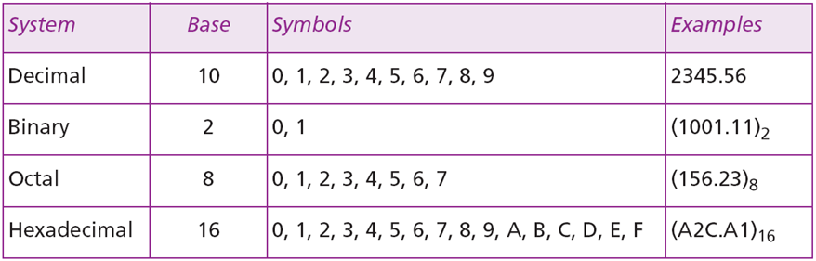
Summary of the Four Number Systems

Slide 55
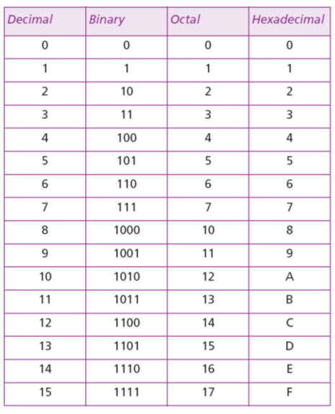
Summary of the Four Number Systems

Slide 56
Conversion
How to covert from any base to decimal
How to convert from decimal to any base
How we can easily convert from binary to hexadecimal or octal and vice versa

Slide 57
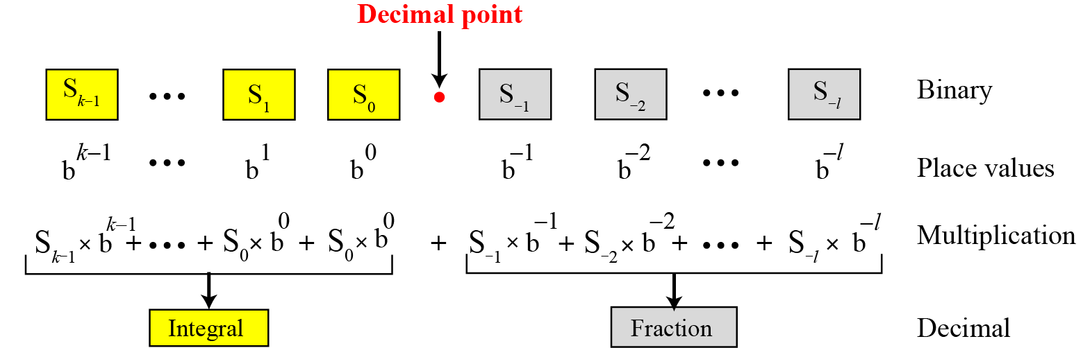
Any Base to Decimal Conversion

Slide 58
Example 1
The following shows how to convert the binary number (110.11)₂ to decimal: (110.11)₂ = 6.75.

Slide 59
Example 2
The following shows how to convert the hexadecimal number (1A.23)₁₆ to decimal.
Note that the result in the decimal notation is not exact, because 3 × 16⁻² = 0.01171875. We have rounded this value to three digits (0.012).

Slide 60
Example 3
The following shows how to convert (23.17)₈ to decimal.
This means that (23.17)₈ ≈ 19.234 in decimal. Again, we have rounded up 7 × 8−2 = 0.109375.

Slide 61
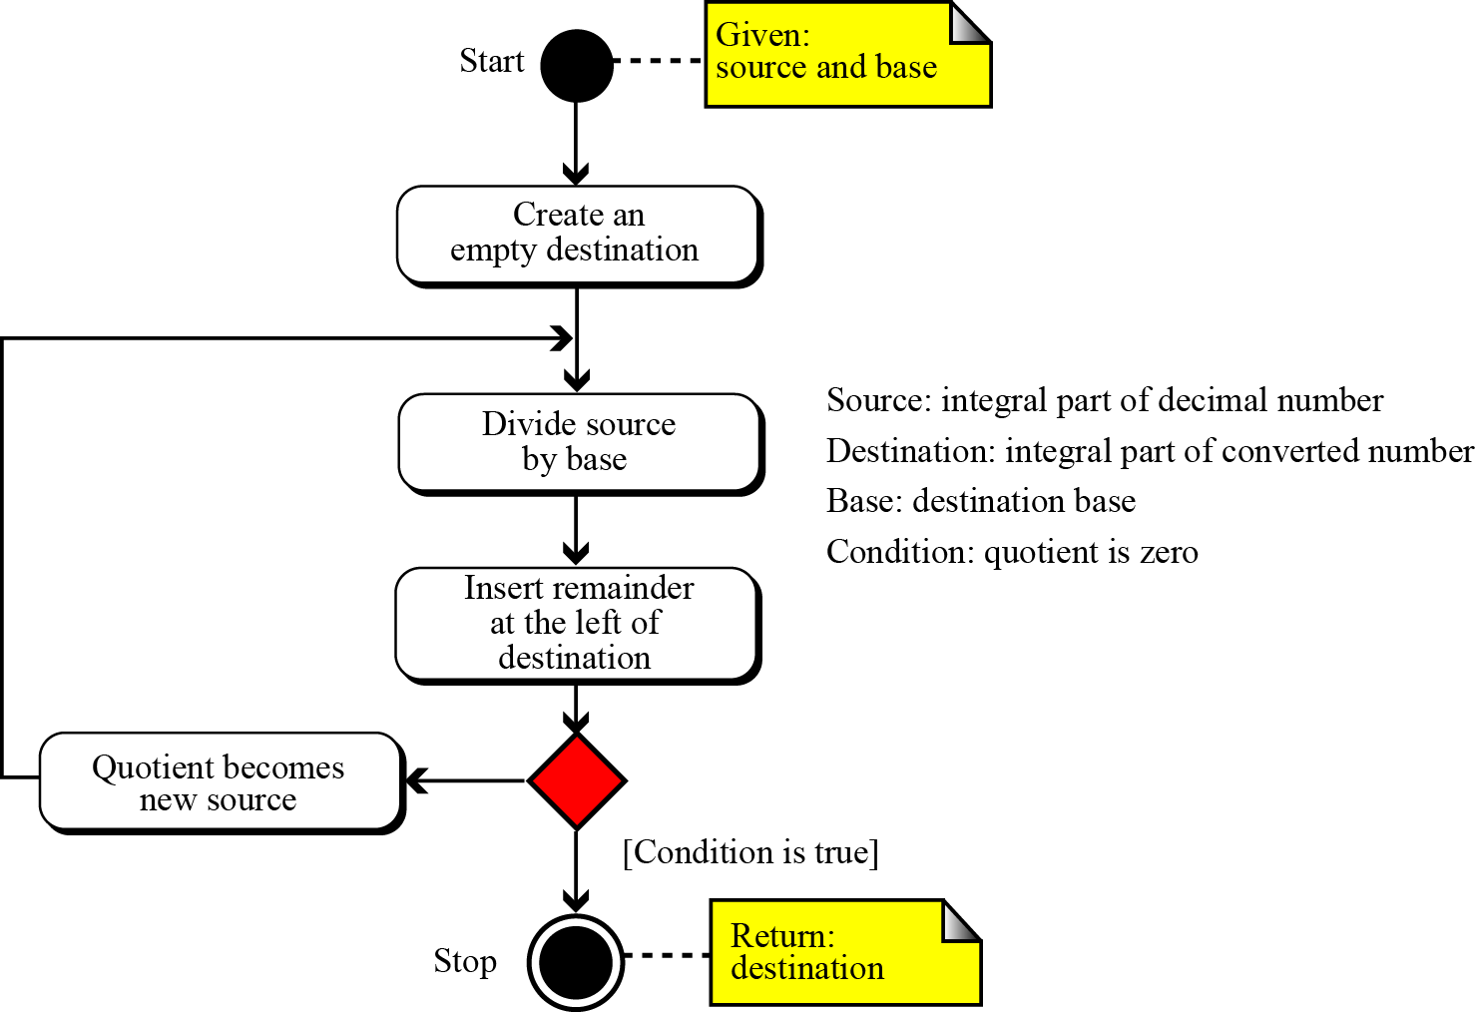
Decimal to Any Base

Slide 62
Example 1
The following shows how to convert 35 in decimal to binary. We start with the number in decimal, we move to the left while continuously finding the quotients and the remainder of division by 2. The result is 35 = (100011)₂.

Slide 63
Example 2
The following shows how to convert 126 in decimal to its equivalent in the octal system. We move to the right while continuously finding the quotients and the remainder of division by 8. The result is 126 = (176)₈.

Slide 64
Example 3
The following shows how we convert 126 in decimal to its equivalent in the hexadecimal system. We move to the right while continuously finding the quotients and the remainder of division by 16. The result is 126 = (7E)₁₆

Slide 65
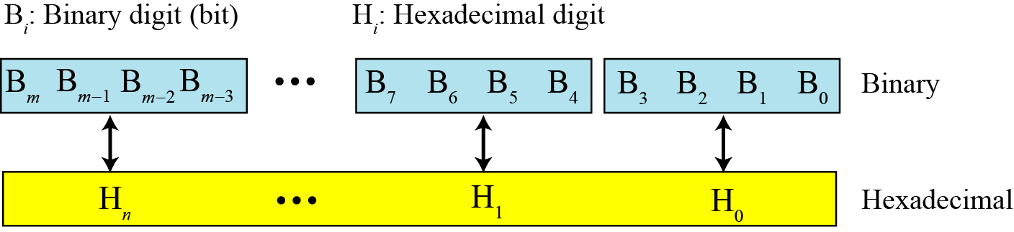
Binary-Hexadecimal Conversion

Slide 66
Example 1
Show the hexadecimal equivalent of the binary number (110011100010)₂.
Solution
We first arrange the binary number in 4-bit patterns:
0100 1110 0010
Note that the leftmost pattern can have one to four bits. We then use the equivalent of each pattern shown in Table on page 54 to change the number to hexadecimal: (4E2)₁₆.

Slide 67
Example 2
What is the binary equivalent of (24C)₁₆?
Solution
Each hexadecimal digit is converted to 4-bit patterns:
2 → 0010, 4 → 0100, and C → 1100
The result is (001001001100)₂.

Slide 68
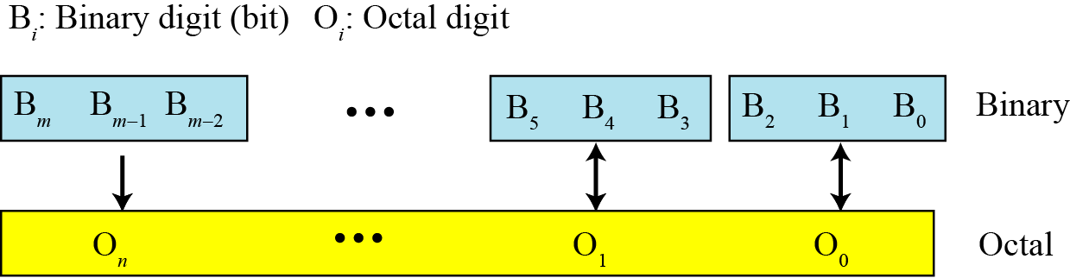
Binary-Octal Conversion

Slide 69
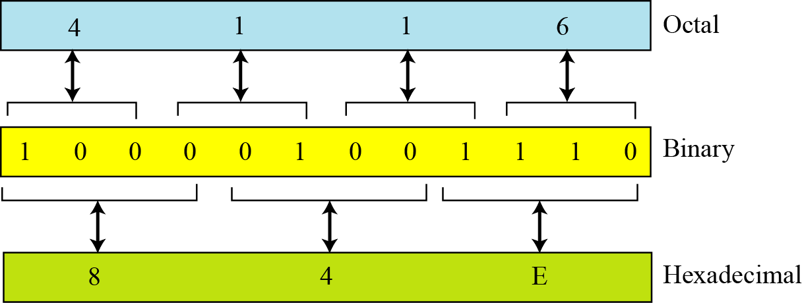
Octal-Hexadecimal Conversion

Slide 70
Computer Science - Fundamental
 | History of Computer
 | Hardware
 | CPU
 | Memory
 | I/O Device
 | Connection
 | Number System
 | Data Storage
 | Software
 | Network

Slide 71
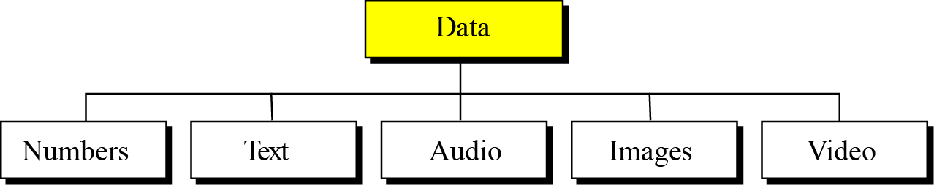
Data Inside the Computer
Different types of data
All data types are transformed into a uniform representation when they are stored in a computer and transformed back to their original form when retrieved. This universal representation is called a bit pattern.

Slide 72
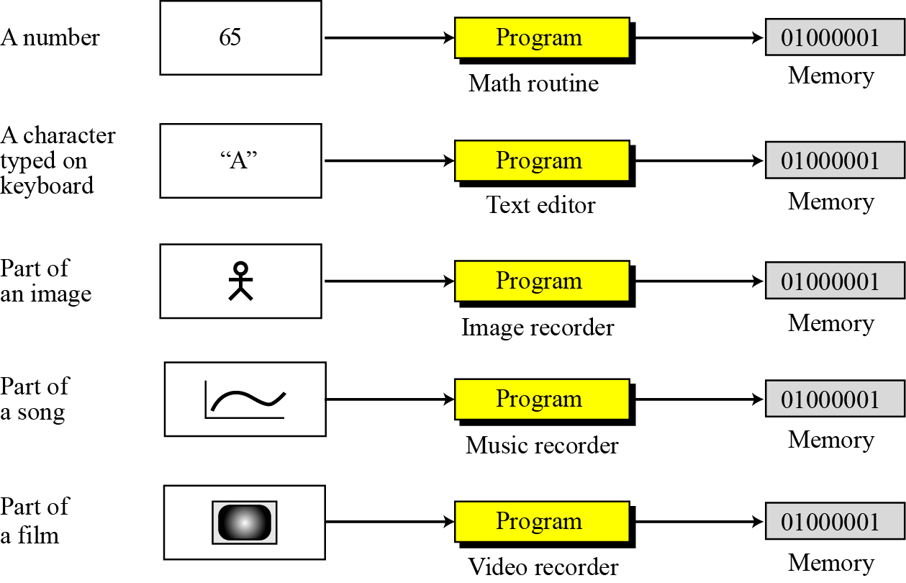
Data Inside the Computer

Slide 73
Storing Numbers
A number is changed to the binary system before being stored in the computer memory, as described in last section. However, there are still two issues that need to be handled:
How to store the sign of the number.
How to show the decimal point.

Slide 74
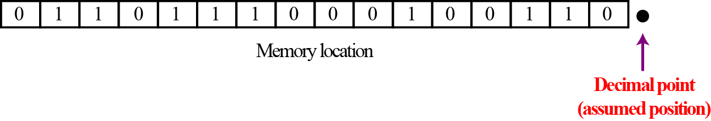
Storing Integers
Integers are whole numbers (numbers without a fractional part).
For example, 134 and −125 are integers, whereas 134.23 and −0.235 are not.
An integer can be thought of as a number in which the position of the decimal point is fixed: the decimal point is to the right of the least significant (rightmost) bit.
For this reason, fixed-point representation is used to store an integer. In this representation the decimal point is assumed but not stored.

Slide 75
Unsigned representation
An unsigned integer is an integer that can never be negative and can take only 0 or positive values. Its range is between 0 and positive infinity.
An input device stores an unsigned integer using the following steps:
The integer is changed to binary.
If the number of bits is less than n, 0s are added to the left.

Slide 76
Example 1
Store 7 in an 8-bit memory location using unsigned representation.
Solution
First change the integer to binary, (111)₂. Add five 0s to make a total of eight bits, (00000111)₂. The integer is stored in the memory location. Note that the subscript 2 is used to emphasize that the integer is binary, but the subscript is not stored in the computer.

Slide 77
Example 2
Store 258 in a 16-bit memory location.
Solution
First change the integer to binary (100000010)₂. Add seven 0s to make a total of sixteen bits, (0000000100000010)₂. The integer is stored in the memory location.

Slide 78
Sign-and-Magnitude Representation
In this method, the available range for unsigned integers (0 to 2^{n} − 1) is divided into two equal sub-ranges. The first half represents positive integers, the second half, negative integers.

Slide 79
Example 1
Store +28 in an 8-bit memory location using sign-and-magnitude representation.
Solution
The integer is changed to 7-bit binary. The leftmost bit is set to 0. The 8-bit number is stored.

Slide 80
Example 2
Store −28 in an 8-bit memory location using sign-and-magnitude representation.
Solution
The integer is changed to 7-bit binary. The leftmost bit is set to 1. The 8-bit number is stored.

Slide 81
Storing Reals
A real is a number with an integral part and a fractional part.
For example, 23.7 is a real number—the integral part is 27 and the fractional part is 7/10.
Although a fixed-point representation can be used to represent a real number, the result may not be accurate or it may not have the required precision.
The next two examples explain why.

Slide 82
Example
Example1
In the decimal system, assume that we use a fixed-point representation with two digits at the right of the decimal point and fourteen digits at the left of the decimal point, for a total of sixteen digits. The precision of a real number in this system is lost if we try to represent a decimal number such as 1.00234: the system stores the number as 1.00.
Example 2
In the decimal system, assume that we use a fixed-point representation with six digits to the right of the decimal point and ten digits for the left of the decimal point, for a total of sixteen digits. The accuracy of a real number in this system is lost if we try to represent a decimal number such as 236154302345.00. The system stores the number as 6154302345.00: the integral part is much smaller than it should be.

Slide 83
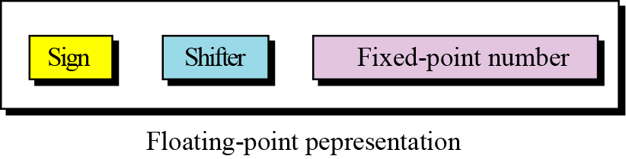
Floating-Point Representation
The solution for maintaining accuracy or precision is to use floating-point representation.

Slide 84
Example 1
The following shows the decimal number
7,452,000,000,000,000,000,000.00
in scientific notation (floating-point representation).
The three sections are the sign (+), the shifter (21) and the fixed-point part (7.425). Note that the shifter is the exponent.

Slide 85
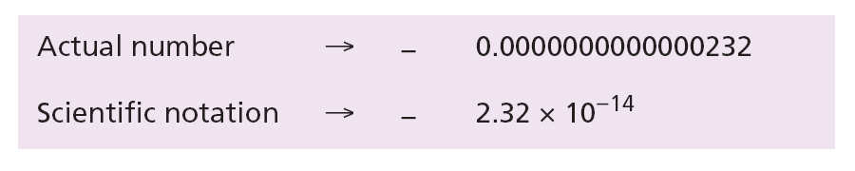
Example 2
Show the number
−0.0000000000000232
in scientific notation (floating-point representation).
Solution We use the same approach as in the previous example—we move the decimal point after the digit 2, as shown below:
The three sections are the sign (−), the shifter (−14) and the fixed-point part (2.32). Note that the shifter is the exponent.

Slide 86
Storing Text
A section of text in any language is a sequence of symbols used to represent an idea in that language.
For example, the English language uses 26 symbols (A, B, C,…, Z) to represent uppercase letters, 26 symbols (a, b, c, …, z) to represent lowercase letters, nine symbols (0, 1, 2, …, 9) to represent numeric characters and symbols (., ?, :, ; , …, !) to represent punctuation.
Other symbols such as blank, newline, and tab are used for text alignment and readability.

Slide 87
Codes
ASCII
Unicode
Other Codes

Slide 88
ASCII
Acronym for the American Standard Code for Information Interchange. ASCII is a code for representing English characters as numbers, with each letter assigned a number from 0 to 127. For example, the ASCII code for uppercase M is 77.
Most computers use ASCII codes to represent text, which makes it possible to transfer data from one computer to another.
The standard ASCII character set uses just 7 bits for each character. There are several larger character sets that use 8 bits, which gives them 128 additional characters. The extra characters are used to represent non-English characters, graphics symbols, and mathematical symbols.

Slide 89
Unicode
A standard for representing characters as integers. Unlike ASCII, which uses 7 bits for each character, Unicode uses 16 bits, which means that it can represent more than 65,000 unique characters.
This is a bit of overkill for English and Western-European languages, but it is necessary for some other languages, such as Greek, Chinese and Japanese.

Slide 90
Other Code
GB2312-80
GB2312-80 is the most used internal code in China.
GB2312-80 defines 6763 Chinese characters and 682 symbols, and most of the characters are simplified Chinese. GB12345-90 corresponds to GB2312-80. Virtually, GB12345-90 remains as traditional Chinese characters, but its code sequence matches GB2312-80. Also, over 100 multi-to-one Chinese characters are added.Arphic now introduces nearly 100 sets of simplified/traditional Chinese characters conforming to the GB2312-80 rule.

Slide 91
Computer Science - Fundamental
 | History of Computer
 | Hardware
 | Software
 | Network

Slide 92
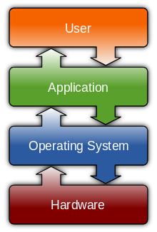
Software
Computer software, or just software, is any set of machine-readable instructions (most often in the form of a computer program) that directs a computer's processor to perform specific operations.
Operating System
Application

Slide 93
Computer Science - Fundamental
 | History of Computer
 | Hardware
 | Software
 | OS
 | Application
 | Programming Language
 | B/S vs C/S
 | License
 | Network

Slide 94
Operating System
An operating system (OS) is a collection of software that manages computer hardware resources and provides common services for computer programs. The operating system is an essential component of the system software in a computer system. Application programs usually require an operating system to function.
Real-time
Multi-user
Multi-tasking vs. single-tasking
Distributed
Embedded

Slide 95
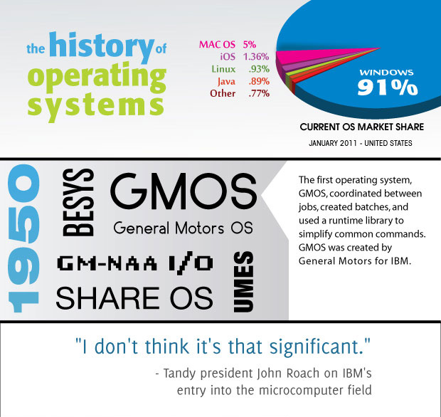
Overview

Slide 96
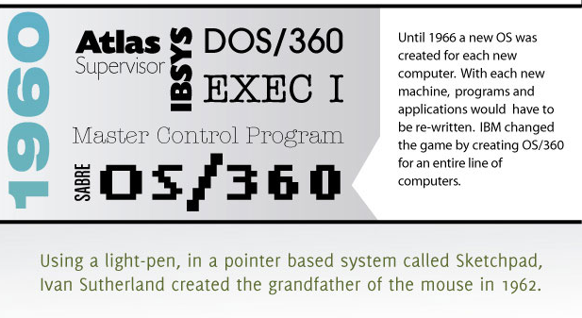

Overview

Slide 97


Overview

Slide 98

Overview

Slide 99
Computer Science - Fundamental
 | History of Computer
 | Hardware
 | Software
 | OS
 | Application
 | Programming Language
 | B/S vs C/S
 | License
 | Network

Slide 100
Application
Application software is all the computer software that causes a computer to perform useful tasks (compare with computer viruses) beyond the running of the computer itself. A specific instance of such software is called a software application, application or app.
Information worker software
Content access software
Entertainment software
Educational software
Enterprise infrastructure software
Simulation software
Media development software
Product engineering software

Slide 101
Computer Science - Fundamental
 | History of Computer
 | Hardware
 | Software
 | OS
 | Application
 | Programming Language
 | B/S vs C/S
 | License
 | Network

Slide 102
Programming Language
A programming language is a formal language designed to communicate instructions to a machine, particularly a computer. Programming languages can be used to create programs that control the behavior of a machine and/or to express algorithms precisely.
Machine Languages
Assembly Languages
High-Level Languages

Slide 103

Programming Language

Slide 104

Machine Languages
In the earliest days of computers, the only programming languages available were machine languages. Each computer had its own machine language, which was made of streams of 0s and 1s.

Slide 105

Assembly Languages
The next evolution in programming came with the idea of replacing binary code for instruction and addresses with symbols or mnemonics. Because they used symbols, these languages were first known as symbolic languages. The set of these mnemonic languages were later referred to as assembly languages.

Slide 106
High-Level Languages
Although assembly languages greatly improved programming efficiency, they still required programmers to concentrate on the hardware they were using. Working with symbolic languages was also very tedious, because each machine instruction had to be individually coded. The desire to improve programmer efficiency and to change the focus from the computer to the problem being solved led to the development of high-level languages.
Over the years, various languages, most notably BASIC, COBOL, Pascal, Ada, C, C++ and Java, were developed.

Slide 107

High-Level Languages

Slide 108

Ranks
TIOBE Programming Community Index for August 2013

Slide 109
Translation
Programs today are normally written in one of the high-level languages. To run the program on a computer, the program needs to be translated into the machine language of the computer on which it will run.
The program in a high-level language is called the source program. The translated program in machine language is called the object program.
Two methods are used for translation: compilation and interpretation.
Compilation
A compiler normally translates the whole source program into the object program.
Interpretation
Some computer languages use an interpreter to translate the source program into the object program. Interpretation refers to the process of translating each line of the source program into the corresponding line of the object program and executing the line. However, we need to be aware of two trends in interpretation: that used by some languages before Java and the interpretation used by Java.

Slide 110

Translation process
Compilation and interpretation differ in that the first translates the whole source code before executing it, while the second translates and executes the source code a line at a time. Both methods, however, follow the same translation process

Slide 111

Programming Paradigms
Today, computer languages are categorized according to the approach they use to solve a problem.
A paradigm, therefore, is a way in which a computer language looks at the problem to be solved. We divide computer languages into four paradigms: procedural, object-oriented, functional and declarative.

Slide 112
Computer Science - Fundamental
 | History of Computer
 | Hardware
 | Software
 | OS
 | Application
 | Programming Language
 | B/S vs C/S
 | License
 | Network

Slide 113
Client/Server
The client–server model is a distributed application structure in computing that partitions tasks or workloads between the providers of a resource or service, called servers, and service requesters, called clients.
Often clients and servers communicate over a computer network on separate hardware, but both client and server may reside in the same system.
A server is a host that is running one or more server programs which share their resources with clients.
A client does not share any of its resources, but requests a server's content or service function. Clients therefore initiate communication sessions with servers which await incoming requests.

Slide 114
Browser/Server (web-based application)
A web-based application is any application that uses a web browser as a client. The term may also mean a computer software application that is coded in a browser-supported programming language (such as JavaScript, combined with a browser-rendered markup language like HTML) and reliant on a common web browser to render the application executable.
Web applications are popular due to the ubiquity of web browsers, and the convenience of using a web browser as a client, sometimes called a thin client. The ability to update and maintain web applications without distributing and installing software on potentially thousands of client computers is a key reason for their popularity, as is the inherent support for cross-platform compatibility.
Common web applications include webmail, online retail sales, online auctions, wikis and many other functions.

Slide 115
Comparison
System Costs
Pros
· Web-based – System is typically offered on a subscription or usage basis, keeping you in control of the costs and allowing you to grow into the system without a huge up-front expense.
· Client-Server – You are in control of upgrades and can cut ties with the software provider if you don’t care to have the newer features or support.
Cons
· Web-based – Subscriptions tend to be ongoing so that over extended years, the system can appear to cost more than an in-house application (though a true cost comparison would have to include may other factors).
· Client-Server – Software is usually paid for up-front and the initial cost of the system can be high. You have high exposure if the system doesn’t turn out to meet your needs. Also, licensing may require a service contract of as much as 20% of the system cost per year, whether you use it or not.

Slide 116
Comparison
Environment
Pros
· Web-based – Hardware, operating system and database software are included in the price of the application. There is no internal cost to your company to purchase, maintain or upgrade the network.
· Client-Server – Internal staff are in full control of the environment. You can make IT decisions that you feel are best.
Cons
· Web-based – The computing environment is typically shared with other customers. While databases are separate and secure, system load can be a factor.
· Client-Server – All costs to purchase, maintain and upgrade the network are on your shoulders and that is typically not your company’s core competency. Pushing off to an ASP can actually save money.

Slide 117
Comparison
IT Support
Pros
· Web-based – Your IT staff is virtually uninvolved in system upgrades, user seat software or database migrations, making your exposure virtually nil. Issues with upgrades are typically dealt with globally, not on a customer-by-customer basis.
· Client-Server – System upgrades, user seat software and database migrations happen when you choose, not on the ASP’s schedule.
Cons
· Web-based – You do not have a say in the management of the network and can be subject to the availability of the ASP’s network administrators.
· Client-Server – You bear all the expense of upgrades, and software vendor can push as many new revisions at you as they choose. Issues with upgrades are difficult as the vendor must typically address them remotely and your unique network configuration can pose unforeseen problems that are not quickly rectified.

Slide 118
Comparison
User Seats
Pros
· Web-based – User seats are typically sessions on a server and not actually software on the user’s computer, allowing access to the system by a larger user base—even customers and vendors.
· Client-Server – Applications tend to run faster when they are local to the user’s computer.
Cons
· Web-based – Remote software requires access to the Internet so users cannot typically make database changes when off-line. Data also has further to travel which can create slower screen response.
· Client-Server – Typically, each user seat must be paid for regardless of how active the user is, pushing you into purchasing seats for users who may seldom use the application. Buying seats for customers or vendors (and providing them remote access) is most likely cost-prohibitive.

Slide 119
Comparison
System Access
Pros
· Web-based – Software is accessed from anywhere with a standard browser and an Internet connection. The user does not even have to be using his or her own computer. Most companies have reasonable Internet access so no additional costs should be incurred.
· Client-Server – Software is accessible through the local network, creating reasonably quick response and autonomy from the Internet.
Cons
· Web-based – Access requires an Internet connection. While access to the Internet is growing, it’s still not everywhere.
· Client-Server – Users must be on the local network to access the software unless the company has invested in a remote access application such as Citrix or PC Anywhere. Remote access applications require additional user software which can be expensive and increase your IT overhead.

Slide 120
Computer Science - Fundamental
 | History of Computer
 | Hardware
 | Software
 | OS
 | Application
 | Programming Language
 | B/S vs C/S
 | License
 | Network

Slide 121
License
A software license is a legal instrument (usually by way of contract law, with or without printed material) governing the use or redistribution of software.
A typical software license grants an end-user permission to use one or more copies of software in ways where such a use would otherwise potentially constitute copyright infringement of the software owner's exclusive rights under copyright law.
Commercial License
Shareware
Freeware
Open Source
Apache
BSD
EPL
GPL/LGPL

Slide 122
Computer Science - Fundamental
 | History of Computer
 | Hardware
 | Software
 | Network

Slide 123
Computer Network
A network is a combination of hardware and software that sends data from one location to another. The hardware consists of the physical equipment that carries signals from one point in the network to another. The software consists of instructions that make the services that we expect from a network possible.

Slide 124
Computer Science - Fundamental
 | History of Computer
 | Hardware
 | Software
 | Network
 | Structure
 | TCP/IP
 | Internet Application

Slide 125
Network Criteria
A network must be able to meet a number of criteria. The most important of these are performance, reliability, and security.
Performance can be measured in many ways, including transit time and response time.
Reliability is measured by the frequency of failure, the time it takes to recover from a failure, and the network’s robustness in a catastrophe.
Network security issues include protecting data from unauthorized access, damage and change, and implementing policies and procedures for recovery from breaches and data losses.

Slide 126

Physical Structures
Before discussing networks, we need to define some network attributes.
Types of Connection: A network consists of two or more devices connected through links. A link is a communications pathway that transfers data from one device to another. There are two possible types of connections: point-to-point and multipoint.

Slide 127

Physical Structures
The term physical topology refers to the way in which a network is laid out physically. There are four basic topologies possible: mesh, star, bus and ring.

Slide 128


Categories of Networks
Today networks can be divided into three broad categories: local-area networks (LANs), wide-area networks (WANs) and metropolitan area networks (MANs).
LAN
WAN

Slide 129

Internet
Today, it is very rare to see a network in isolation: networks are connected to one another. When two or more networks are connected, they become an internet.

Slide 130

Internet
The most notable internet is the Internet (uppercase “I”), a collaboration of hundreds of thousands of interconnected networks. Private individuals, as well as various organizations such as government agencies, schools, research facilities, corporations and libraries in more than 100 countries use the Internet. Millions of people are users.
It is difficult to give an accurate representation of the Internet, because it is continually changing. Today, most end users who want an Internet connection use the services of Internet service providers (ISPs).

Slide 131
Intranet
An intranet is a computer network that uses Internet Protocol technology to share information, operational systems, or computing services within an organization.
This term is used in contrast to internet, a network between organizations, and instead refers to a network within an organization.
Sometimes, the term refers only to the organization's internal website, but may be a more extensive part of the organization's information technology infrastructure, and may be composed of multiple local area networks.
The objective is to organize each individual's desktop with minimal cost, time and effort to be more productive, cost efficient, timely, and competitive.

Slide 132
Computer Science - Fundamental
 | History of Computer
 | Hardware
 | Software
 | Network
 | Structure
 | TCP/IP
 | Internet Application

Slide 133
TCP/IP Protocol
To divide the services required to perform a task, the Internet has created a set of rules called protocols.
These allow different local and wide area networks, using different technologies, to be connected together and carry a message from one point to another.
The set, or suite, of protocols that controls the Internet today is referred to as the TCP/IP protocol suite.
Transmission Control Protocol (TCP)
Internet Protocol (IP)

Slide 134

TCP/IP Protocol
The original TCP/IP protocol suite was defined as having four layers: host-to-network (or link), internet (network), transport and application. However, the TCP/IP protocol suite today is normally considered as a five-layer model

Slide 135

TCP/IP Protocol
Below figure shows the layers involved when a message is sent from device A to device B. As the message travels from A to B, it may pass through many routers. Routers use only the first three layers

Slide 136

Application Layer
The application layer enables a user, whether human or software, to access the network. It provides support for services such as electronic mail, remote file access and transfer, browsing the World Wide Web, and so on.
When a client needs to send a request to a server, it needs the server application-layer address. For example, to identify one particular site, the client uses a Uniform Resource Locator (URL). As we will see later, the server application-layer address is not used for delivery of messages, it only helps the client to find the actual address of the server computer.

Slide 137

Transport Layer
The transport layer is responsible for process-to-process delivery of the entire message: logical communication is created between the transport layer of the client and the server computer. In other words, although physical communication is between two physical layers (through many possible links and routers), the two application layers consider the transport layer as the agent that takes responsibility for delivering the messages.

Slide 138

Transport Layer
The server computer may be running several processes at the same time, for example an FTP server process and an HTTP server process. When the message arrives at the server, it must be directed to the correct process. We need another address for server process identification, called a port number.

Slide 139
Transport Layer
During the life of the TCP/IP protocol suite three transport layer protocols have been designed: UDP, TCP and SCTP.
The User Datagram Protocol (UDP) is the simplest of all three protocols. UDP does multiplexing and de-multiplexing It also does a type of error control by adding a checksum to the packet.
Transmission Control Protocol (TCP) is a protocol that supports all the duties of a transport layer. However, it is not as fast and as efficient as UDP. TCP uses sequence numbers, acknowledgment numbers and checksums. It also uses buffers at the sender’s site. This combination of provisions provides multiplexing, de-multiplexing, flow control, congestion control and error control.
Stream Control Transmission Protocol (SCTP) is a new protocol that is designed for new services expected from the Internet, such as Internet telephony and video streaming. This protocol combines the advantages of both UDP and TCP. Like UDP, it is suitable for real-time transmission of audio and video, but like TCP, it provides error and flow control.

Slide 140

The Network Layer
The network layer is responsible for the source-to-destination (computer-to-computer or host-to-host) delivery of a packet, possibly across multiple networks (links). The network layer ensures that each packet gets from its point of origin to its final destination.
The packet traveling from the client to the server and the packet returning from the server need a network-layer address. The server address is provided by the server, as discussed above, while the client address is known by the client computer.

Slide 141

The Network Layer
The network layer has a specific duty: routing. Routing means determination of the partial or total path of a packet. As the Internet is a collection of networks (LANs, WANs, and MANs), the delivery of a packet from its source to its destination may be a combination of several deliveries: a source-to-router delivery, several router-to-router delivery, and finally a router-to-destination delivery.

Slide 142
The Network Layer
The TCP/IP protocol suite supports one main protocol (IP) and several auxiliary protocols to help IP to perform its duties.
In the TCP/IP protocol suite, the main protocol at the network layer is Internet Protocol (IP). The current version is IPv4 (version 4) although IPv6 (version 6) is also in use, although not ubiquitously. IPv4 is responsible for the delivery of a packet from the source computer to the destination computer. For this purpose, every computer and router in the world is identified by a 32-bit IP address, which is presented in dotted decimal notation.

Slide 143
The Network Layer
The notation divides the 32-bit address into four 8-bit sections and writes each section as a decimal number between 0 and 255 with three dots separating the sections. For example, an IPv4 address
00001010 00011001 10101100 00001111
is written as
10.25.172.15

Slide 144

Data Link Layer
As we saw in the previous section, the network layer packet may pass through several routers in its journey from its source to its destination. Carrying the packet from one node to another (where a node can be a computer or a router) is the responsibility of the data link layer.

Slide 145

Data Link Layer
Two questions that come to mind are how computer A knows the data-link layer address of router R1, or router R1 knows the data-link layer address of router R4. A device can find the data-link address of another device either statically or dynamically.

Slide 146
Data Link Layer
Unlike IP addresses, addresses at the data-link layer cannot be universal. Each data link protocol may have a different address format and size.
The Ethernet protocol, the most prevalent local area network in use today, uses a 48-bit address, which is normally written in hexadecimal format (grouped in six sections, each with two hexadecimal digits) as shown below:
07:01:02:11:2C:5B

Slide 147

Physical Layer
The physical layer coordinates the functions required to carry a bit stream over a physical medium. Although the data link layer is responsible for moving a frame from one node to another, the physical layer is responsible for moving the individual bits that make up the frame to the next node. In other words, the unit of transfer in the data link layer is a frame, while the unit of transfer in the physical layer is a bit.

Slide 148

Summary

Slide 149

An Exchange Using the TCP/IP Model

Slide 150
Computer Science - Fundamental
 | History of Computer
 | Hardware
 | Software
 | Network
 | Structure
 | TCP/IP
 | Internet Application

Slide 151
Internet Application
The main task of the Internet is to provide services for users. Among the most popular applications are electronic mail, remote login, file transfer and accessing the World Wide Web (WWW). We briefly discuss these applications in this section.

Slide 152

Electronic-mail

Slide 153

Mail Access Protocols
Stored e-mail remains on the mail server until it is retrieved by the recipient through an access protocol. Currently two e-mail access protocols are in common use: Post Office Protocol, Version 3 (POP3) and Internet Mail Access Protocol (IMAP).

Slide 154

Mail Access Protocols
Simple Mail Transfer Protocol (SMTP) is an Internet standard for electronic mail (e-mail) transmission across Internet Protocol (IP) networks.
Multipurpose Internet Mail Extension (MIME) is a supplementary protocol that allows non-ASCII data to be sent through SMTP. MIME is not an e-mail protocol and cannot replace SMTP, it is only an extension to SMTP.

Slide 155

File Transfer Protocol (FTP)
File Transfer Protocol (FTP) is the standard mechanism for one of the most common tasks on the Internet, copying a file from one computer to another.

Slide 156


Remote Login – TELNET
The main task of the application layer is to provide services for users. One way to satisfy these demands is to create different client-server application programs for each desired service.
Programs such as file transfer programs (FTP and SMTP), and so on are already available. However, it would be impossible to write a client-server program for each specific application.
TELNET is a general-purpose client-server program that lets a user access any application program on a remote computer. In other words, it allows the user to log onto a remote computer. After logging on, a user can use the services available on the remote computer and transfer the results back to the local computer.
Local Login
Remote Login

Slide 157
The World Wide Web (WWW)
The World Wide Web (WWW), or just “the Web”, is a repository of linked information spread all over the world. The WWW has a unique combination of flexibility, portability and user-friendly features that distinguish it from other services provided by the Internet. The WWW today is a distributed client-server service in which a client using a browser can access a service using a server. However, the service provided is distributed over many locations, called web sites.
The WWW uses the concept of hypertext and hypermedia. In a hypertext environment, information is stored in a set of documents that are connected together using the concept of links.

Slide 158

The World Wide Web (WWW)

Slide 159

The World Wide Web (WWW)
To use the WWW we need three components: a browser, a web server and a protocol called Hypertext Transfer Protocol (HTTP).

Slide 160


The World Wide Web (WWW)
Hypertext Transfer Protocol (HTTP) is a protocol used mainly to access data on the World Wide Web.
A client that wants to access a document needs an address. To facilitate the access of documents distributed throughout the world, HTTP uses the concept of locators. The uniform resource locator (URL) is a standard for specifying any kind of information on the Internet.

Slide 161

www.capgemini.com/financialservices

